Slide 1
Notes:
Hello everyone… Thanks for coming out tonight.

Slide 2


Visual Studio 2017 Azure in the ATL Launch Party
What’s New with Office and SharePoint Development?
Notes:
Why does a SharePoint and Office developer care about Visual Studio 2017 or Visual Studio Code?
There have been some significant changes to the Office and SharePoint development story in the past couple years and Visual Studio 2017 and Visual Studio Code now support and enhance these changes.

Slide 3
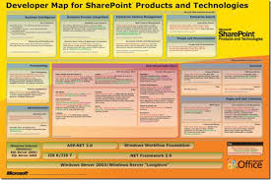
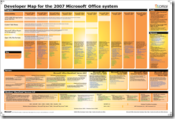
The Past
SharePoint Development
Local Server Required
Full Trust Code
Difficult to Brand
Challenging Testing & ALM
SharePoint Specific!
Office Development
COM Based
Full Trust Code
Challenging Testing & ALM
Deployment Challenges
Office Client Specific!
Notes:
If you are familiar with SharePoint or Office Addin Development from the past, they had their challenges.
Full trust, client side code
Challenging ALM stories
COM – need I say more!
Being a SharePoint or Office developer often meant picking a platform to focus on in order to become productive.
The development experience, API’s, tools, ALM – they were very specific to SharePoint or Office, depending on your focus.
Whenever I tell people I am a SharePoint and Office developer, I get that familiar look – you know that look – the “SharePoint Stare”.
While most developers embraced web based development years ago, SharePoint and Office developers seem to be constantly lagging behind.
We seemed to still be stuck in the old world of server side development for SharePoint or event COM.
SharePoint and Office development have al ways been valuable, but never cool…!

Slide 4
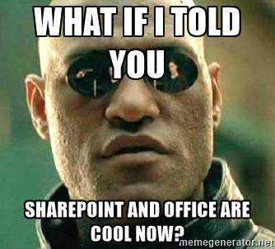
Notes:
But recent changes in Office and SharePoint mean that SharePoint and Office development are now productive, valuable AND cool!

Slide 5
“Office development IS web-based development.”*
*https://dev.office.com/blogs/happy-anniversary-visual-studio
Notes:
Application development in general has embraced the web, JavaScript, REST, WebHooks, OAuth, microservices , and more…
I have a good friend and fellow SharePoint dev who used to refer to SharePoint the platypus. While the rest of the world moved on to ORM’s, EntityFramework, ASP.NET MVC, whatever javascript framework came out yesterday, and more - SharePoint, and Office, just seemed to be in the evolutionary backwater and stuck using ASP.NET 20 infrastructure, COM and just constantly behnd the times from a technology perspective.
Well, now Office and SharePoint development are catching up... In a big way!
The Office Dev Team’s comment for Visual Studio’s on it’s 20th birthday was that “Office development IS web based development!”
Visual Studio 2017 and Visual Studio Code, combined with significant Office and SharePoint platform changes, should help stop that “SharePoint Stare”!

Slide 6





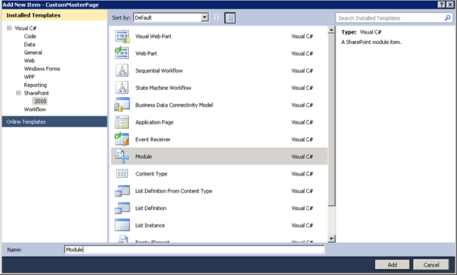





Office and SharePoint Development Tools
Project Templates
Notes:
The tooling for SharePoint and Office have changed dramatically in the last couple of years… Let’s walk through some of the changes
1 - A typical SharePoint development story used start with typical .NET/C# path.
2 – We had However, once you got to the SharePoint project templates in Visual Studio, things got weird. Features, and Solutions, List Templates, and GUID’s everywhere!!
5 – Once you got coding, at least you were using C# most of the time
6 - But you needed to love XML!!
7 -But now SharePoint and Office development is web based development so SharePoint and Office also can start with Node and NPM for client side frameworks and tools
8 – The old SharePoint and Office templates have gotten some updates, and are now Open Source Office and SharePoint Yoeman generators
11 – We now use TypeScript, Angular, React or o any other framework to combine with the Graph API, the Office and SharePoint JavaScript Object Models or other custom or 3rd party API's
12 – and we can combine our familiar build processes with the current build and bundling tools as well and all of the goodness from Visual Studio 2017!.
See I told you SharePoint was cool!

Slide 7
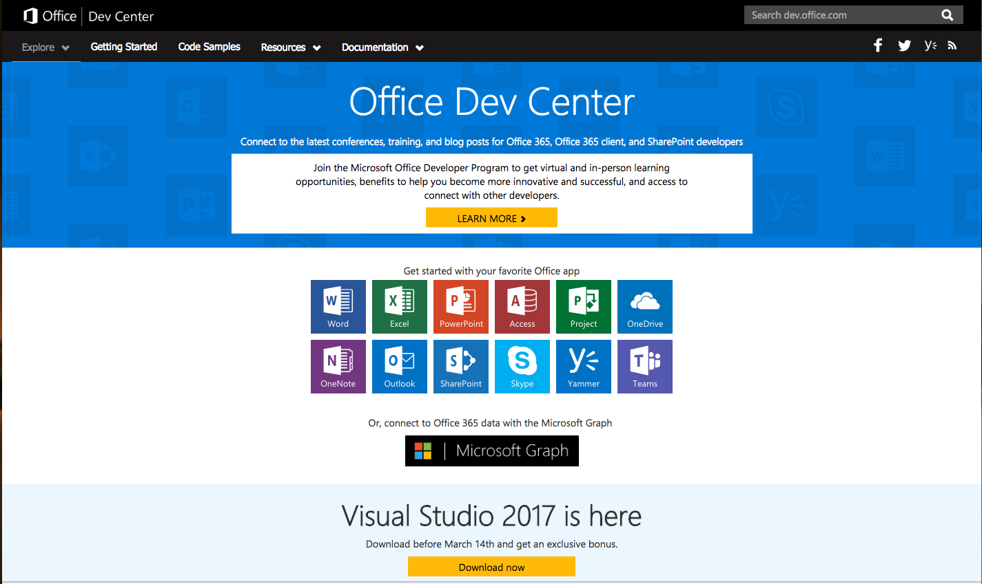
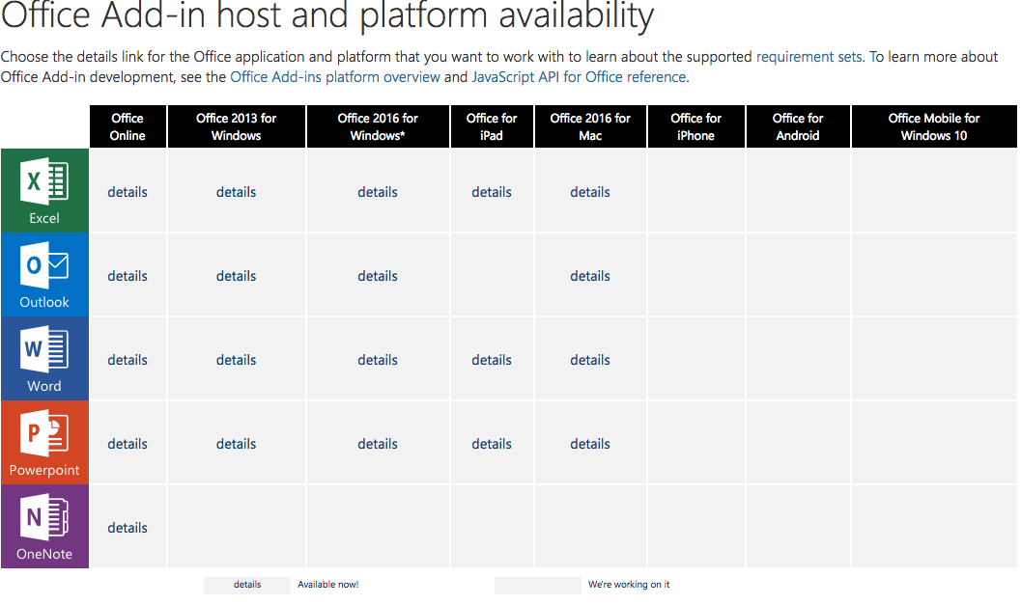
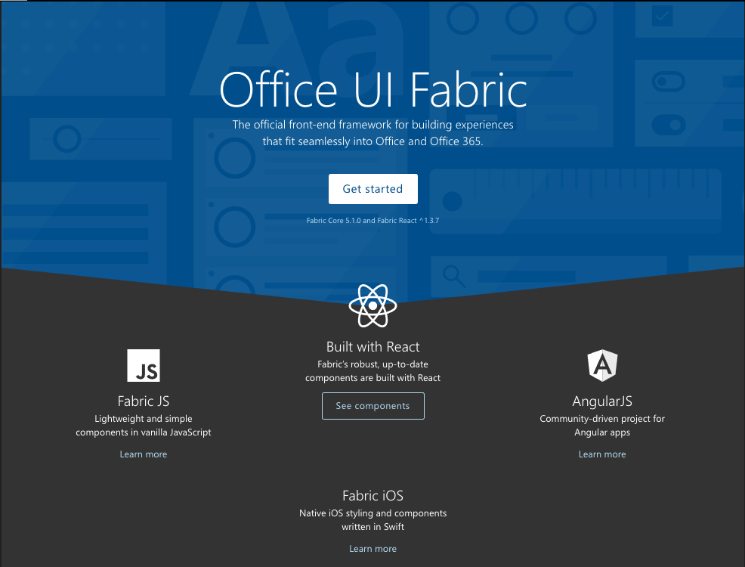
Office and SharePoint Development
Notes:
As I said, the development story for Office and SharePoint undergone some radical updates in the last couple years.
Office and SharePoint development now covers the entire Office Suite
The familiar Word, Excel, and PowerPoint,
But also Skype, Teams One Note – event Visio is getting a JavaScript API!
Since these apps are now built using standard web technologies, integrating with the authentication services, the Graph API, Azure Services, or even your own Web API’s is a familiar experience.
While building these apps, you likely want to make your applications fit seamlessly into Office and Office 365 and the Office UI Fabric framework gives you the ability to do just that .
The best part of the new Office and SharePoint applications is that these addins work on the Web, on the Desktop, and on mobile clients!

Slide 8
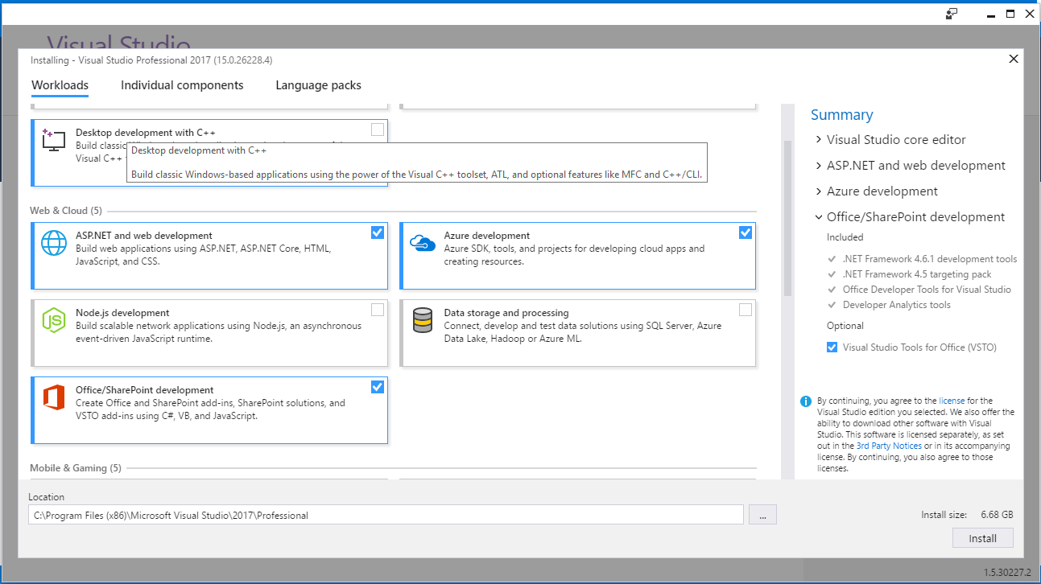
Visual Studio 2017 Office and SharePoint Workloads
Notes:
Visual Studio 2017 makes it easy to get started by selecting the workloads you will need.
We come back to the them of Web Development, so we’ll need the ASP.NET and the Azure development workloads
Once you install VS 2017, I now have access to publish to Azure, Connect to Services like the Office Graph, or Application Insights, and all the benefits of Visual Studio 2017.

Slide 9

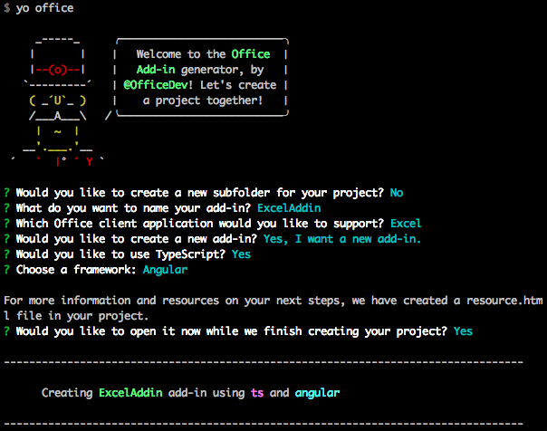
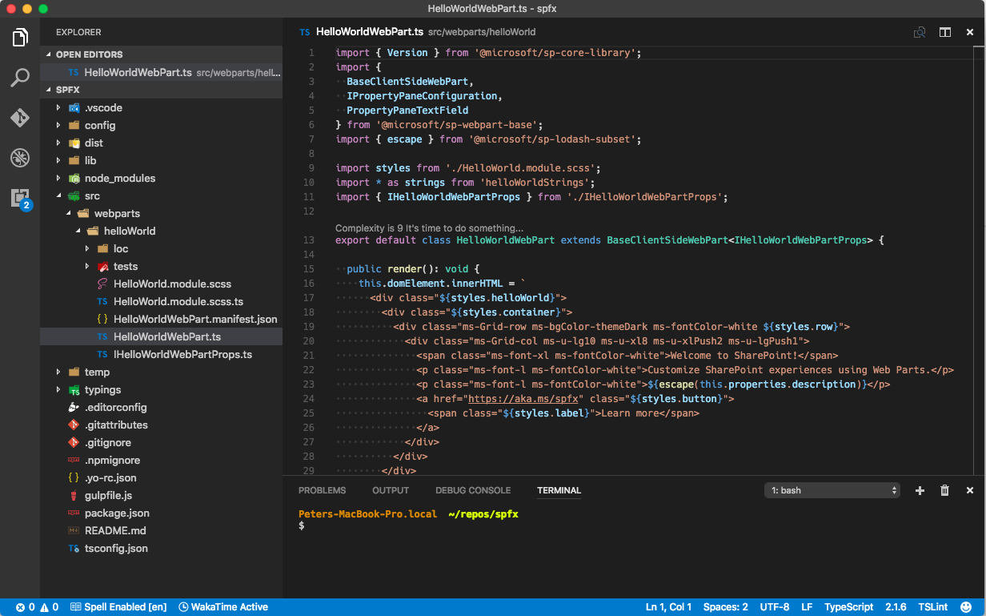
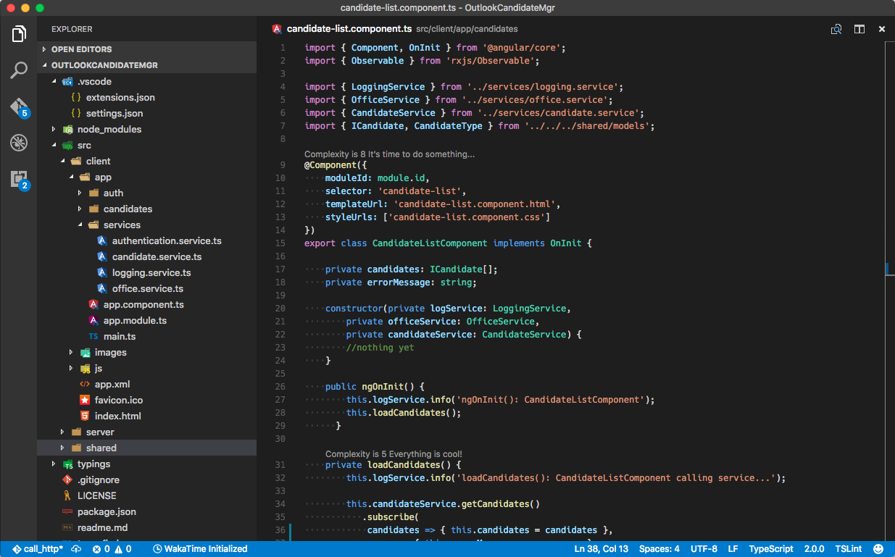
Visual Studio Code
SharePoint Framework
Office Addins
Notes:
I’ll use Visual Studio 2017 for the heaving lifting and for the great integartion with Connect Services, but I am a big fan of Visual Studio code
The Yoeman generators Office and SharePoint let me get a solution up and functioning really quickly.

Slide 10
Demos
Notes:
Let’s check out some Demo’s…

Slide 11
Demo 1 – VS Code + Yo + Outlook Addin

Slide 12
Demo 2 – VS Code + Yo + SPFx Web Part
https://github.com/SharePoint/sp-dev-docs/blob/master/docs/spfx/web-parts/get-started/connect-to-sharepoint.md
Notes:
Gulp serve
Change the text in the web part
Show the react template for the web part…

Slide 13
Demo 3 – VS 2017 Office Addin
Word Addin in Visual Studio 2017

Slide 14

THANK YOU!
Download Visual Studio 2017!
Download Visual Studio Code
Visit dev.office.com
www.visualstudio.com

Slide 15

Pete Skelly
ThreeWill, LLC
SharePoint + Office 365 User Group
Principal, Director of Technology
Twitter: @pskelly
https://peteskelly.com
http://www.threewill.com/pskelly
pskelly@threewill.com
Notes:
Thanks for the opportunity to show you some of the new options for SharePoint and Office development.
Feel free to grab my contact info or come talk to me tonight if you want to know more.

Slide 16
Resources
https://dev.office.com
JavaScript API for Office
SharePoint Framework Guidance
Office Addins with Yeoman
https://github.com/officedev/generator-office
Word Addin Sample
https://github.com/OfficeDev/Word-Add-in-DocumentAssembly
Notes:
Finally, here are some resources for folks to find out more about Office and SharePoint development.

